Slide 1

Database Lab 7
Database Modification
Addendum
Dr. Jefferson Fong

Slide 2
Announcements
Assignment 2 has been released in iSpace.
  Due Sunday Nov 9, 11:59 pm
Project Groups
Is in iSpace under Section 1002 / 1005
Every group should have at least 1 or 2 people taken System and Web Development workshop.
  Let us know if that’s not so.
Project description due Sun Nov 9.
Project ER diagram due Sun Nov 23.

Slide 3
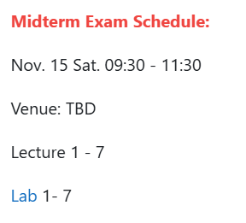
Announcements
Anyone who cannot attend at that time must apply for official excuse form in order to take the make-up test.
Closed book, no notes or any electronic devices allowed.
Bring a pen (or two) and your UIC or government issued photo ID card.

Slide 4
Slide 2
The file “UIC definition.txt” contains the solution to last week’s exercise.
  Run these SQLs first – copy and paste them to XAMPP.
  Check out the tables created.
The folder Data contains Book.txt, Borrow.txt, etc.
  These txt files contain data for tables.
  You can copy data from these txt files into your insert statements, so you don’t have to do so much typing.
  You can copy the phrases from the txt files.
  You cannot copy quotes and double-quotes from Word and Powerpoint into XAMPP; they are illegal characters in XAMPP.

Slide 5
Slide 3
If the schema (in red) is left out of the insert statement, the user need to know the default order of the values.
Using the schema, the user don’t need to know the default order. The user can change the order.
  INSERT INTO program (director_id, p_code, p_name, division)
  VALUES (NULL, 1005, ‘AI', ‘Computer Science’);
Slide 11
A lot of data to enter; do enough so you get the idea.

Slide 6


